Slide 1
Social Networks and Image Recognition
By: Daniel Kraft and Steven Stuglia

Slide 2
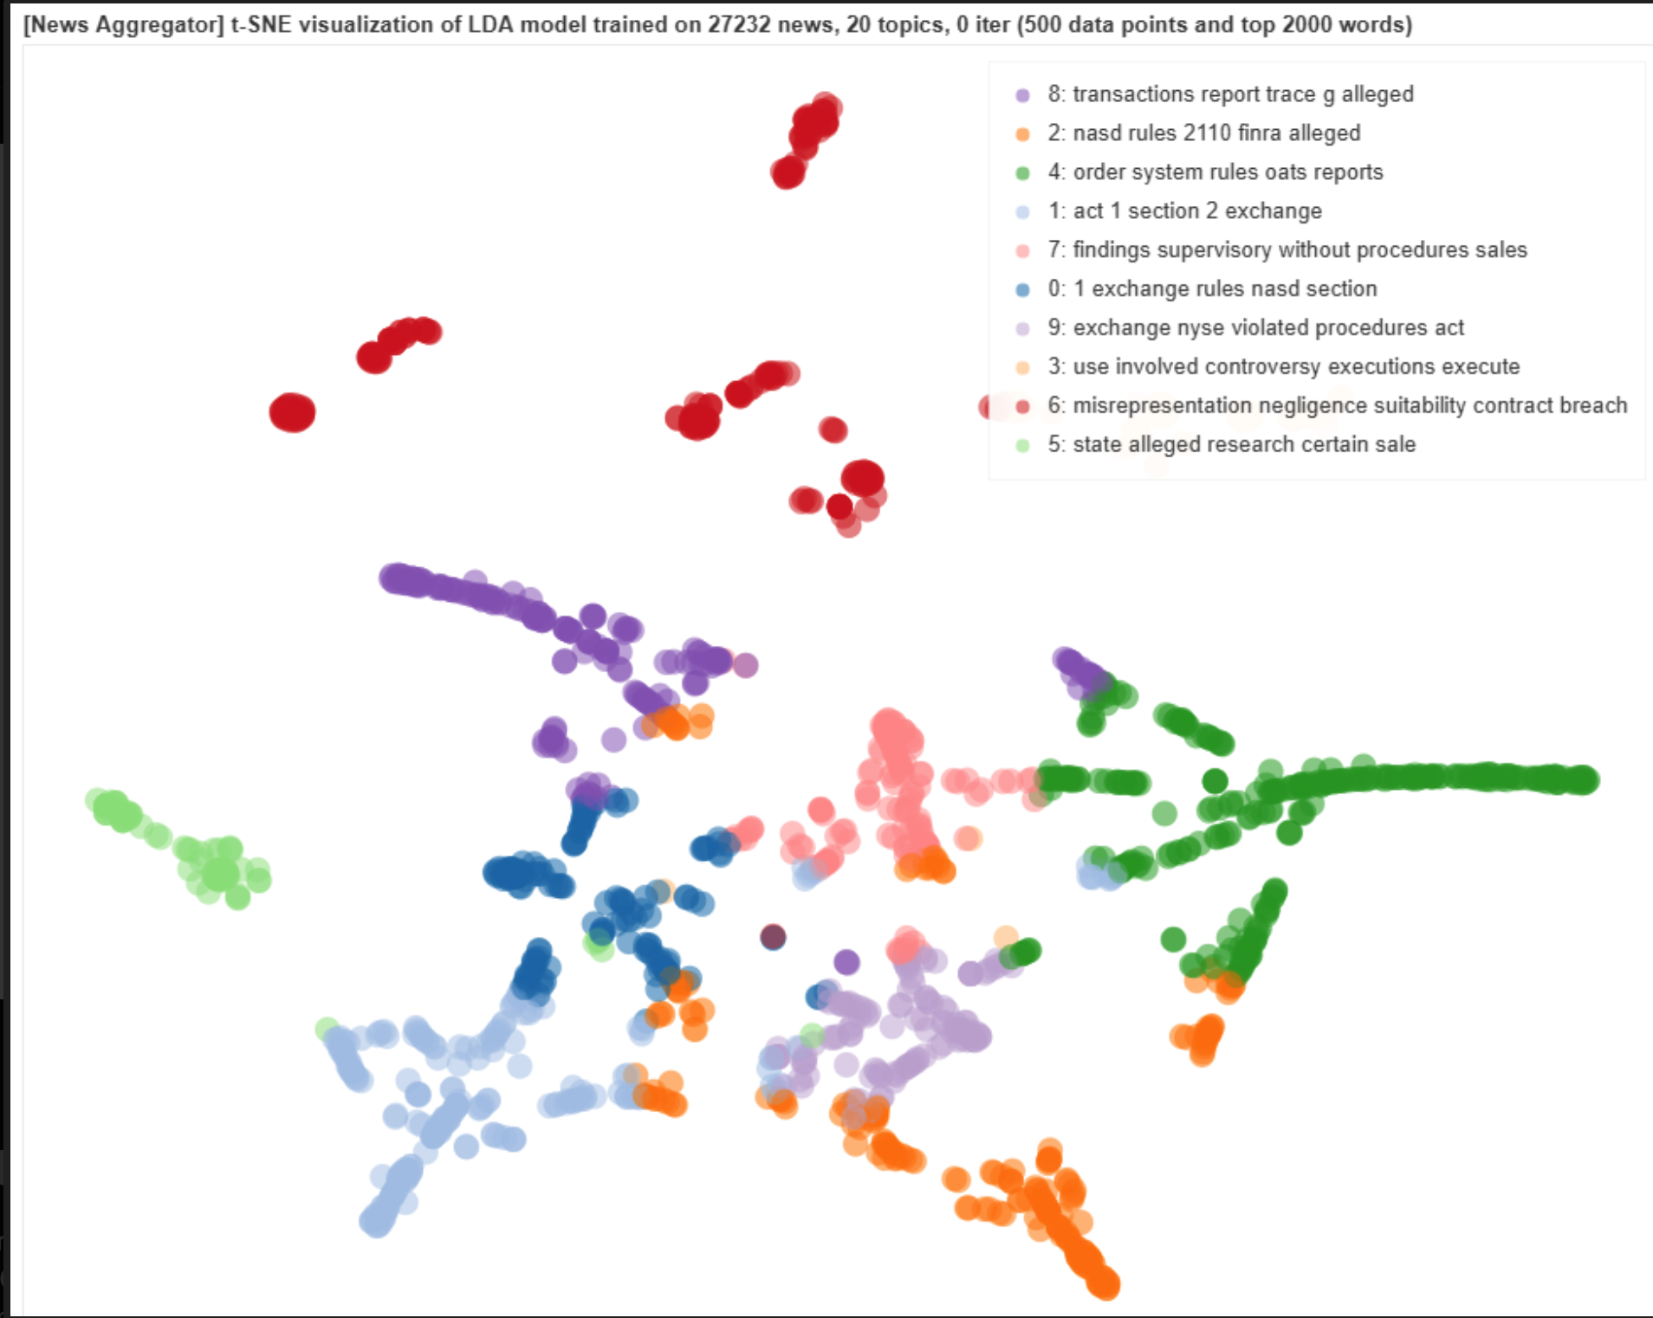
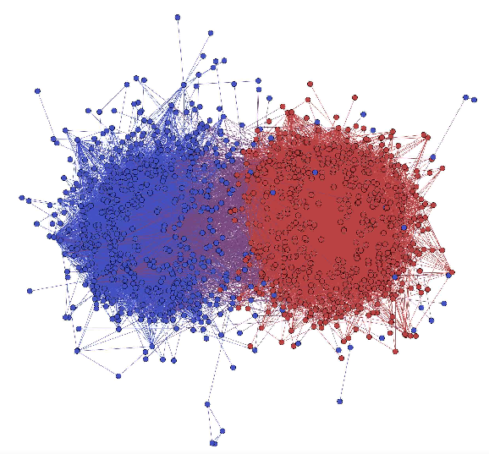
Practical Uses of Community Detection

Slide 3
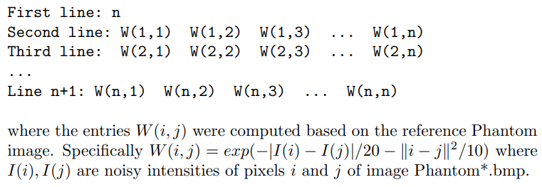
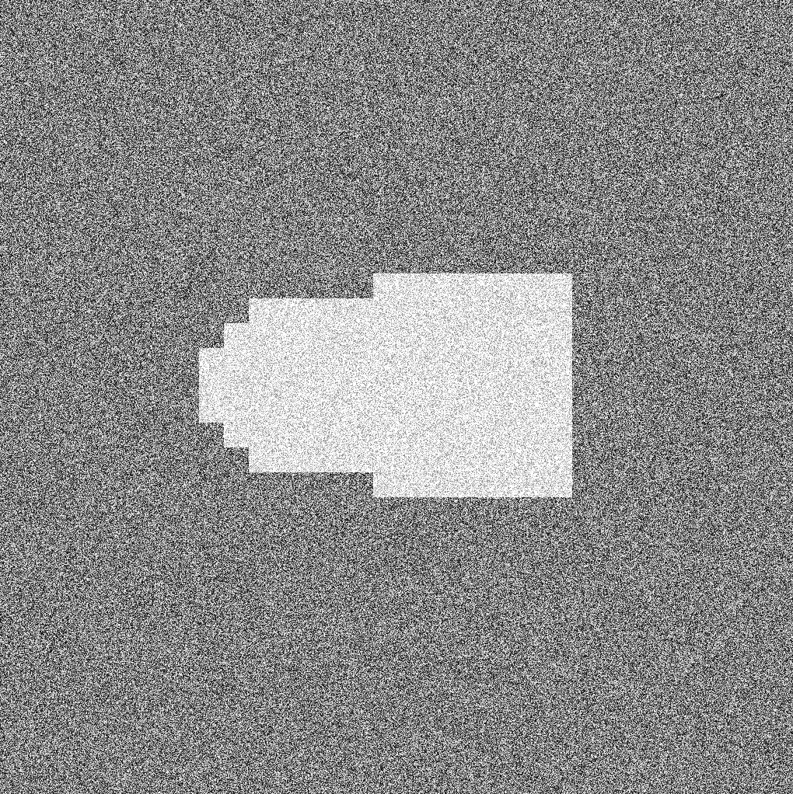

Our Data

Slide 4
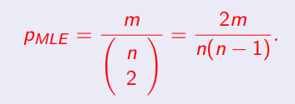


Erdos-Renyi Random Graph Model Testing
Estimated p Value
0.2768
Estimated 3-Cliques | Actual 3-Cliques
3,786,100 | 9,552,971
Estimated 4-Cliques | Actual 4-Cliques
20,505,000 | 417,952,847

Slide 5
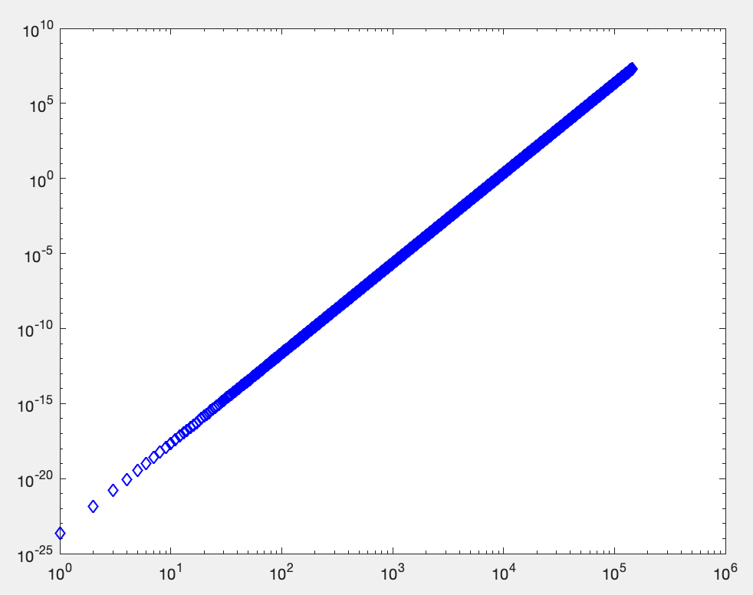
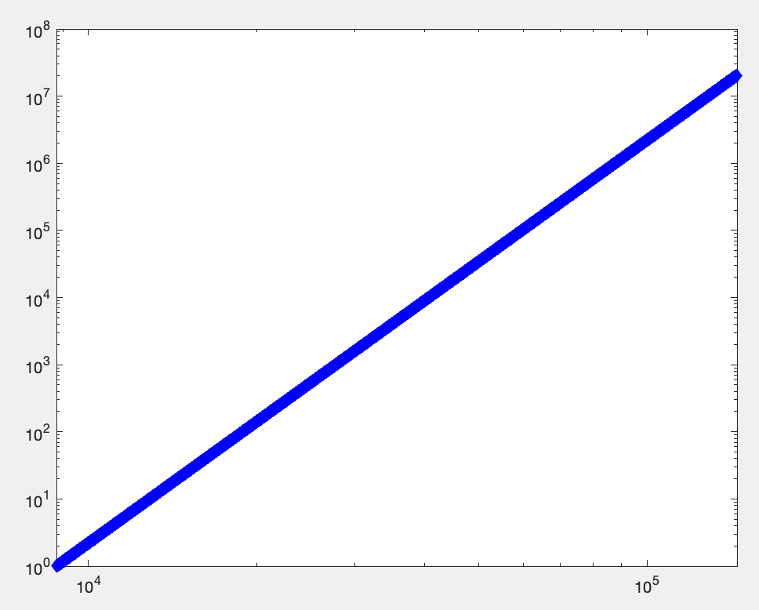
Erdos Renyi Random Graph 4-Clique Prediction
Log-Log Plot (With All Edges)
Log-Log Plot (With Edges : X₄ ≥ 1)
a_{ER} = 6.0 b_{ER} = -54.471
a_{ER} = 6.0 b_{ER} = -54.471

Slide 6



Stochastic Block Graph Model Testing
m = # edges n = # nodes t = # 3 cliques = (1/6)trace(A^3)
a = 0.5954 b = 0.0417
Expected X₄ = 2.5325 x 10⁸ Actual X₄ = 4.1795 x 10⁸.

Slide 7
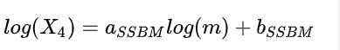
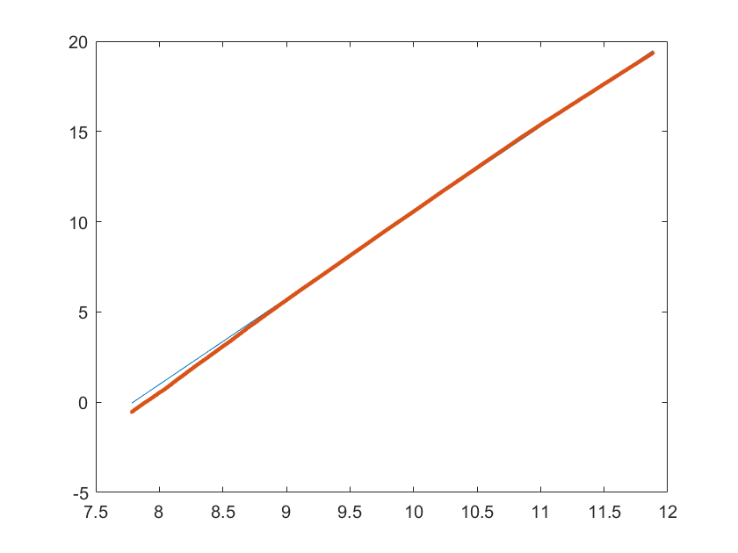
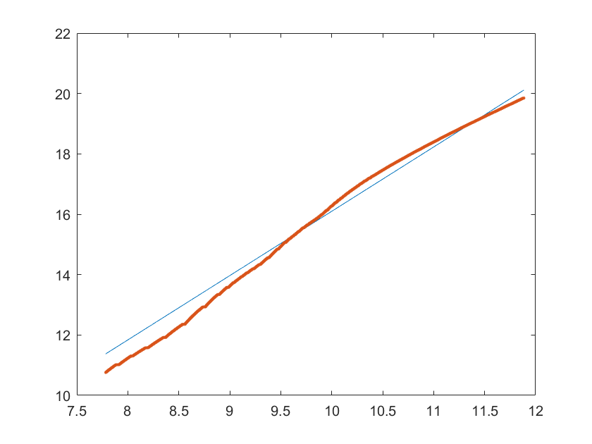
Stochastic Block Model Graph 4-Clique Prediction
Log-Log Plot of Estimated 4-Cliques
Log-Log Plot of 4-Cliques
a_{SSBM} =4.7631 b_{SSBM} = -37.1215
a₀ = 2.130547 b₀ = -5.2078

Slide 8
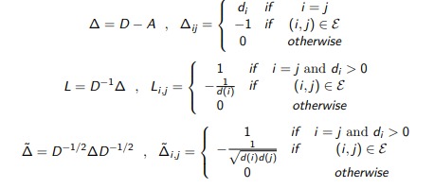
Spectral and SDP Partitions

Slide 9
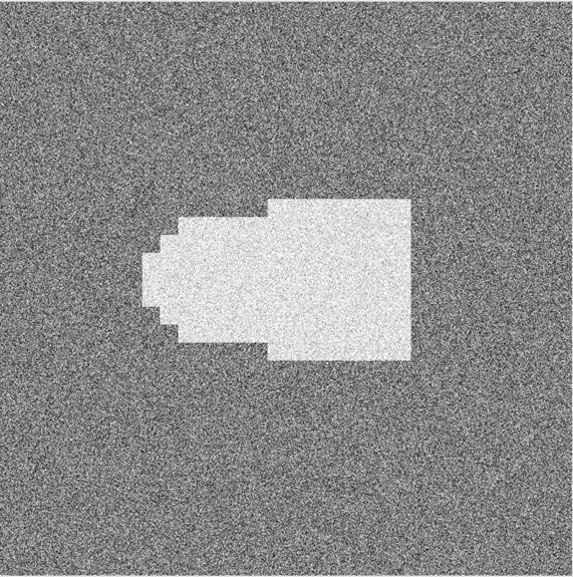
High Resolution Noisy Phantom

Slide 10

Spectral Algorithm using the Weight Matrix

Slide 11

Spectral Algorithm using the Graph Laplacian

Slide 12

Spectral Algorithm using the Symmetric Normalized Weighted Graph Laplacian

Slide 13

Weight Matrix SDP

Slide 14
The Graph Laplacian SDP

Slide 15

Weighted Graph Laplacian SDP

